Slide 1

AI-Driven Academic Risk & Dropout Early-Warning System
Presented by
Altrin Benser A - 962223205010 John Jins J - 962223205032
Jerish Rethna J - 962223205029 Mukhilan S - 962223205040
Guide:
Er. Agnes Alex Rathy P
Assistant Professor/IT
Notes:
Good morning. This is our Review 2 for the mini project: an AI-driven academic risk and dropout early-warning system, which we call Digital Class Twin. It keeps a continuously updated digital twin of every student and predicts dropout risk early. Our team is Altrin Benser, John Jins, Jerish Rethna and Mukhilan, working under our guide, Er. Agnes Alex Rathy P. Today we cover the problem, literature, design, algorithm, implementation progress and conclusion.

Slide 2
Abstract, Problem Statement & Objectives
Abstract
Traditional systems find weak students only after exam results and keep data as static records.
Digital Class Twin captures attendance, assessment, quiz and behavior data as events and keeps a live digital twin of each student.
Risk is scored with explainable factors and shown on role-based dashboards for teachers, counselors and parents.
Problem Statement
Weak students are identified only after examination or semester results.
Static records do not show how performance changes over time.
Attendance-threshold rules miss the complete academic situation.
No mechanism for continuous monitoring and early intervention.
Objectives
Continuously collect attendance, assessment and behavior data
Maintain a Digital Twin per student: current state, history, sync status
Predict academic risk: Low, Medium, High
Predict future GPA using machine learning (planned)
Analyze trajectory: Declining, Stable, Recovering
Give explainable factors behind every prediction
Provide what-if simulation for interventions
Support early intervention by recording actions and outcomes
Notes:
Our abstract in simple words: weak students are usually found only after exam results, and their data sits in static records. Digital Class Twin captures attendance, assessments, quizzes and behaviour as events and keeps a live digital twin of each student, with explainable risk shown on role-based dashboards. The problem is late detection, static records, simple attendance rules and no continuous monitoring. Our objectives are to collect data continuously, maintain a twin per student, predict risk as low, medium or high, predict future GPA, analyse the trajectory, explain predictions, simulate what-if interventions, and support early intervention.

Slide 3
Related Sustainable Development Goals (SDG)
PRIMARY SDG
SDG 4: Quality Education
SDG 10: Reduced Inequalities
SECONDARY SDG
SDG 10
Early identification can help students who need extra academic support
Supports more equitable access to timely guidance
A supporting link, not a claim to remove inequality
SDG 4
Closest match to our project objective
Early identification of academically at-risk students for timely support
SDG 9: Industry, Innovation & Infrastructure
SECONDARY SDG
Risk score from academic performance, attendance and behavior
Low / Moderate / High levels show who needs help first
Dashboards let teachers and parents act early
Aims to improve educational outcomes and reduce dropout
SDG 9
Applies digital-twin concepts to student academic profiles
Data-driven analytics and digital dashboards in education
Rule-based risk engine today; trained ML planned
The project primarily contributes to SDG 4 by supporting early identification of academic risk and timely educational intervention.
Notes:
This slide shows how our project aligns with the UN Sustainable Development Goals. Our primary goal is SDG 4, Quality Education. Our system analyses academic performance, attendance and behaviour, calculates a risk score, and classifies students as low, moderate or high risk, so teachers and parents can identify at-risk students early and give timely support. Our secondary goal is SDG 10, Reduced Inequalities: early identification can help students who need additional academic support, but we do not claim that the project removes educational inequality. Our supporting goal is SDG 9, Industry, Innovation and Infrastructure: we apply digital twin concepts, data-driven analytics and digital dashboards in education. Please note our risk engine is currently rule-based, and trained machine learning is planned future work. In short, the project primarily contributes to SDG 4.

Slide 4
Literature Survey , Summary and Research Gap
Research Gap
Major Methods
  Many studies use static or institution-specific datasets.
  Most focus mainly on prediction rather than continuous monitoring.
  Limited integration of academic, attendance and behavioural events.
  Few systems connect predictions directly with interventions.
  Machine Learning: Random Forest, Decision Tree, SVM, Logistic Regression
  Ensemble & Boosting methods for dropout prediction
  Educational Data Mining and Learning Analytics
  SHAP / Explainable AI for prediction interpretation
  Digital Twin & graph-based student pathway modelling
Key Findings
Relevance to Our Project
  ML can predict academic performance and dropout risk at an early stage.
  Attendance, academic performance, LMS activity and behaviour are important indicators.
  Combining multiple student data sources improves risk prediction.
  XAI helps identify the factors influencing predictions.
  Our Digital Class Twin extends existing ML and Digital Twin approaches.
  Uses event-driven continuous monitoring and time-series student state.
  Provides Low/Medium/High risk, GPA prediction and trajectory-based urgency.
  Uses SHAP, What-If simulation and intervention logging for actionable decisions.
Notes:
We reviewed twenty papers from 2021 to 2025. Most use machine learning such as random forest, decision trees, support vector machines and boosting, plus educational data mining and SHAP for explanation. They show that attendance, academic performance and behaviour can predict risk early. But many use static, institution-specific data, focus on prediction only, rarely combine academic, attendance and behaviour events, and seldom connect predictions to interventions. This is our research gap, and Digital Class Twin addresses it with event-driven continuous monitoring, explainable risk and intervention support.

Slide 5
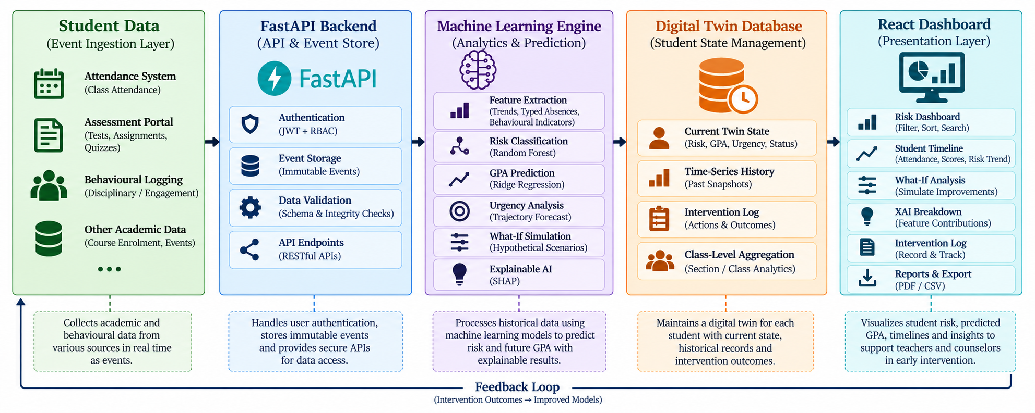


Proposed System Architecture
Events → FastAPI ingestion → Rules & features → Risk engine → Twin & alerts → Database → REST API (JWT) → React dashboards
Notes:
This is our proposed architecture. Attendance, assessment and behaviour events enter through the FastAPI backend. Rules and the feature engine turn them into features, and the risk engine scores the student. The twin engine saves the student state and snapshots, and the alert engine raises alerts. Everything is stored in a database, exposed through REST APIs secured with JWT, and shown in React dashboards for students, teachers, parents and admins. Note: the current implementation uses a rule-based risk engine; the machine learning engine shown here is the planned next step.

Slide 6
Implementation Details (Framework, Design)
Layer | Technologies
Frontend | React, Vite, Axios, React Router, custom CSS
Backend | Python, FastAPI, Uvicorn, Pydantic
Database | SQLAlchemy ORM (SQLite dev), Alembic migrations
Security | JWT authentication, password hashing, role-based access
ML engine | Python; rule-based scoring (risk_engine.py, forecasting_engine.py)
Tools | Git/GitHub, Swagger (/docs), Postman
Notes:
Here are the implementation details. For the framework: React with Vite and Axios on the frontend; Python with FastAPI, Uvicorn and Pydantic on the backend; SQLAlchemy with SQLite for development and Alembic for migrations; JWT with password hashing and role-based access for security; and Git, Swagger and Postman as tools. The design is split into four modules: backend, client app, ML engine and shared contracts. We have role-based dashboards for student, teacher, parent and admin, backed by REST routers for authentication, events, twins, insights, alerts and more.

Slide 7
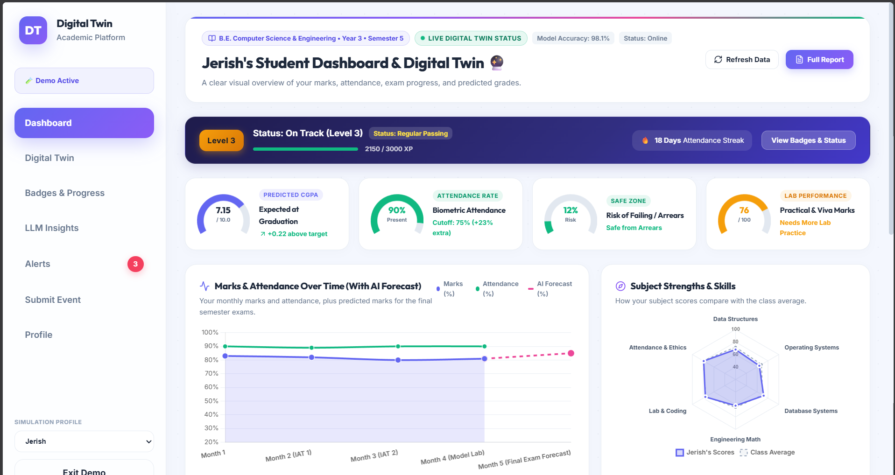
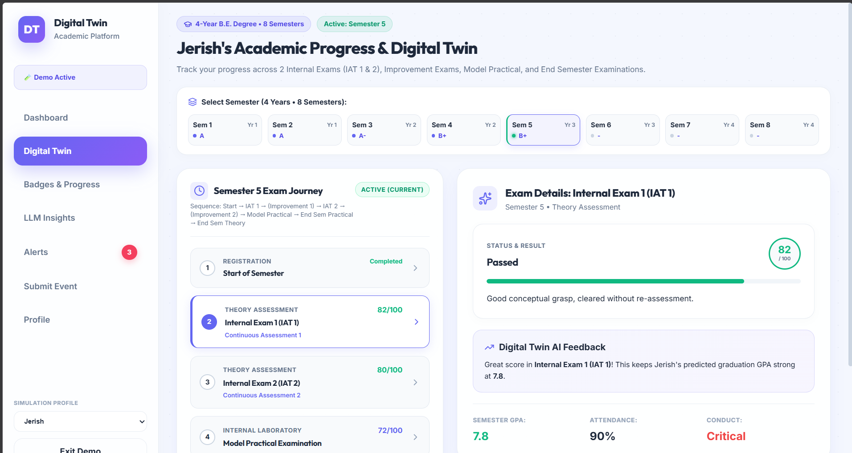
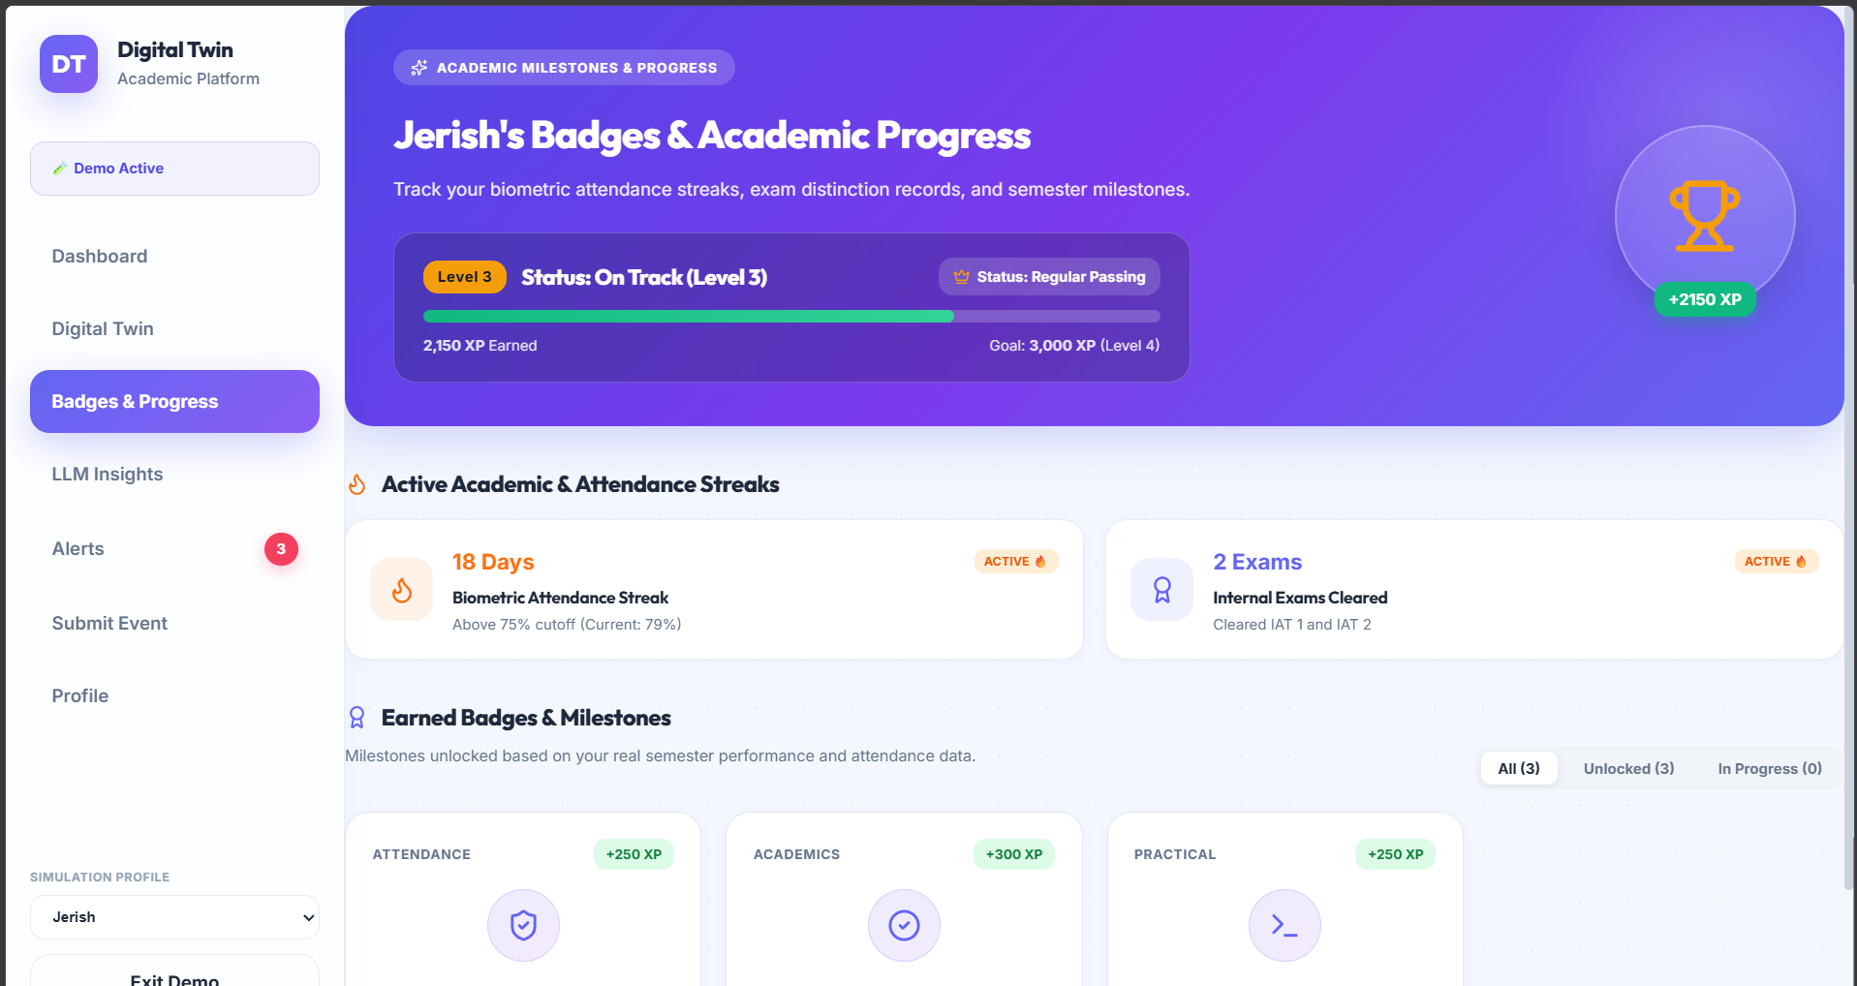
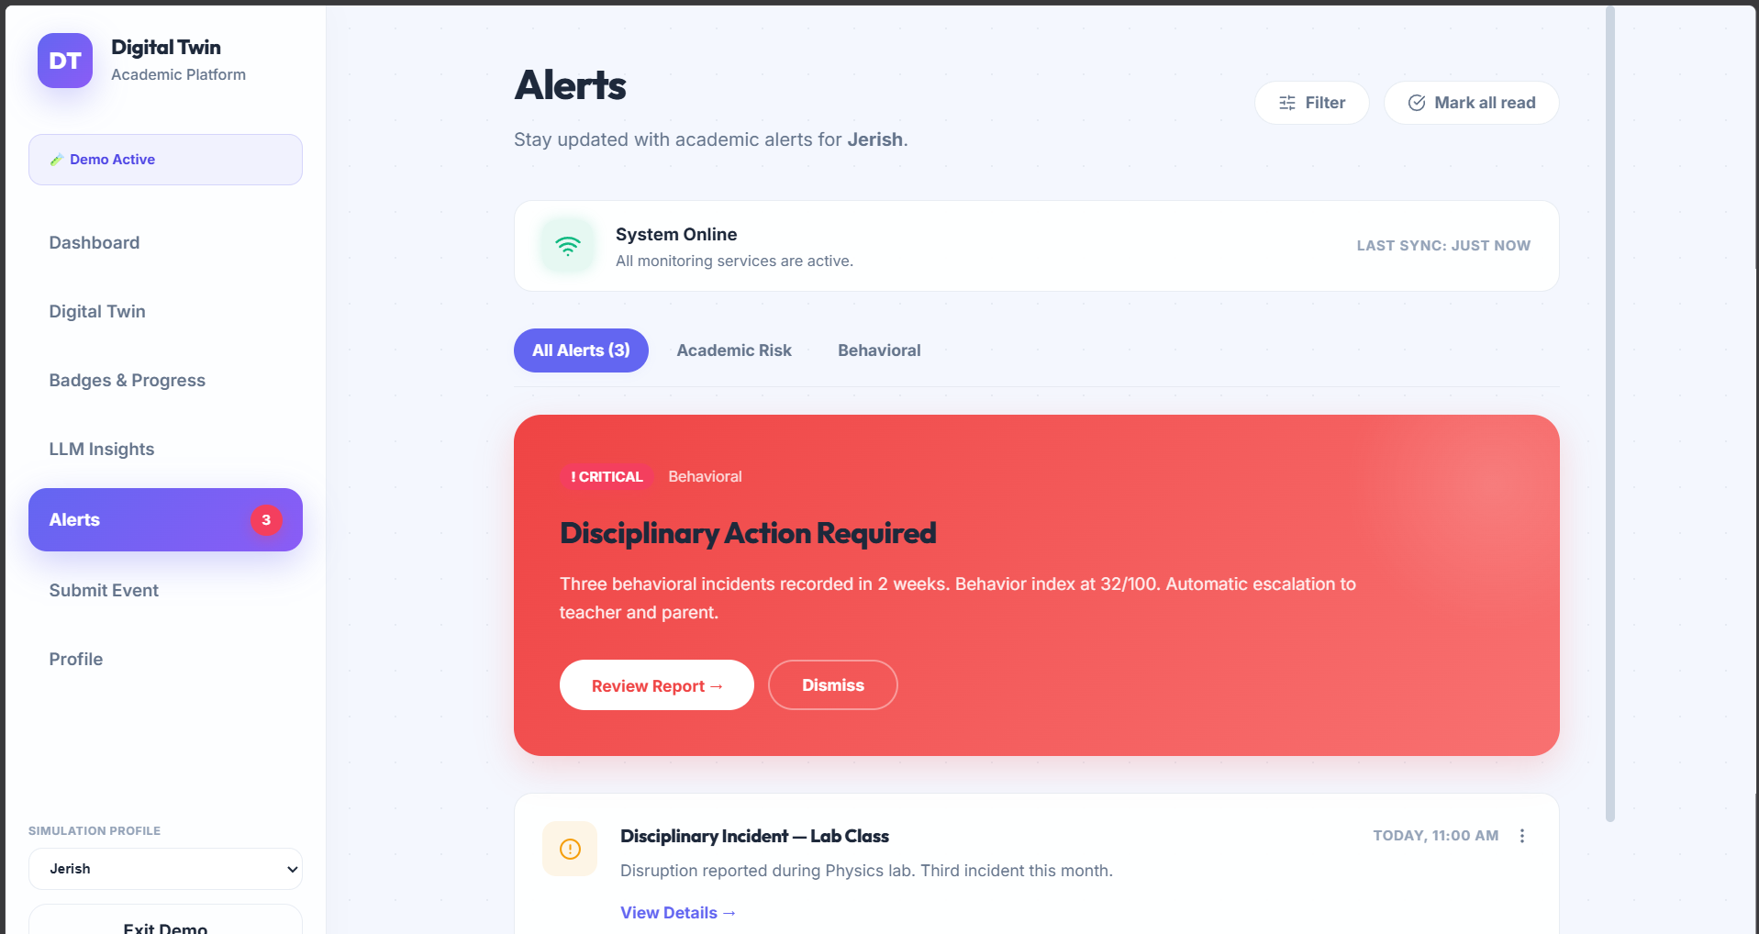
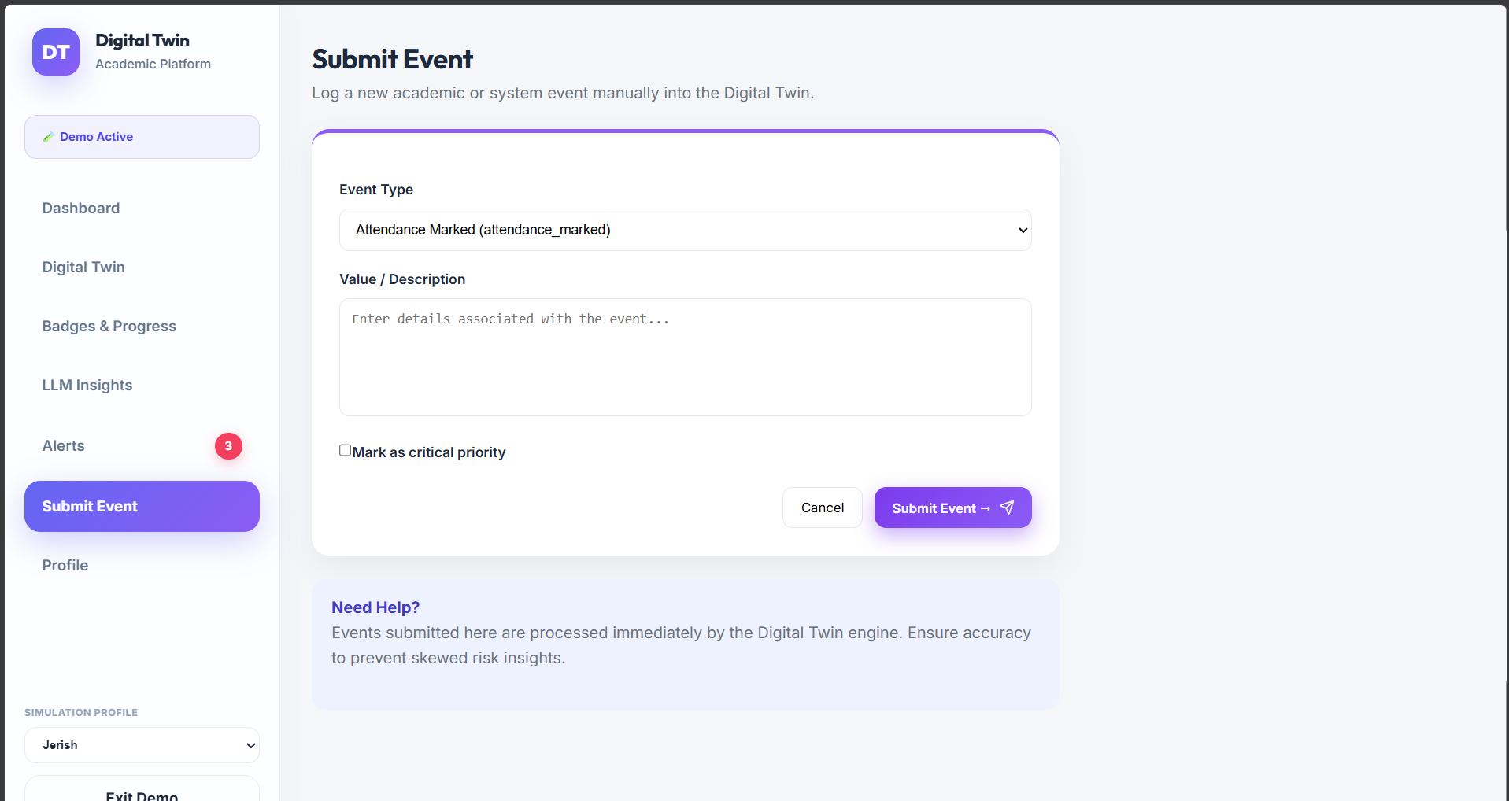
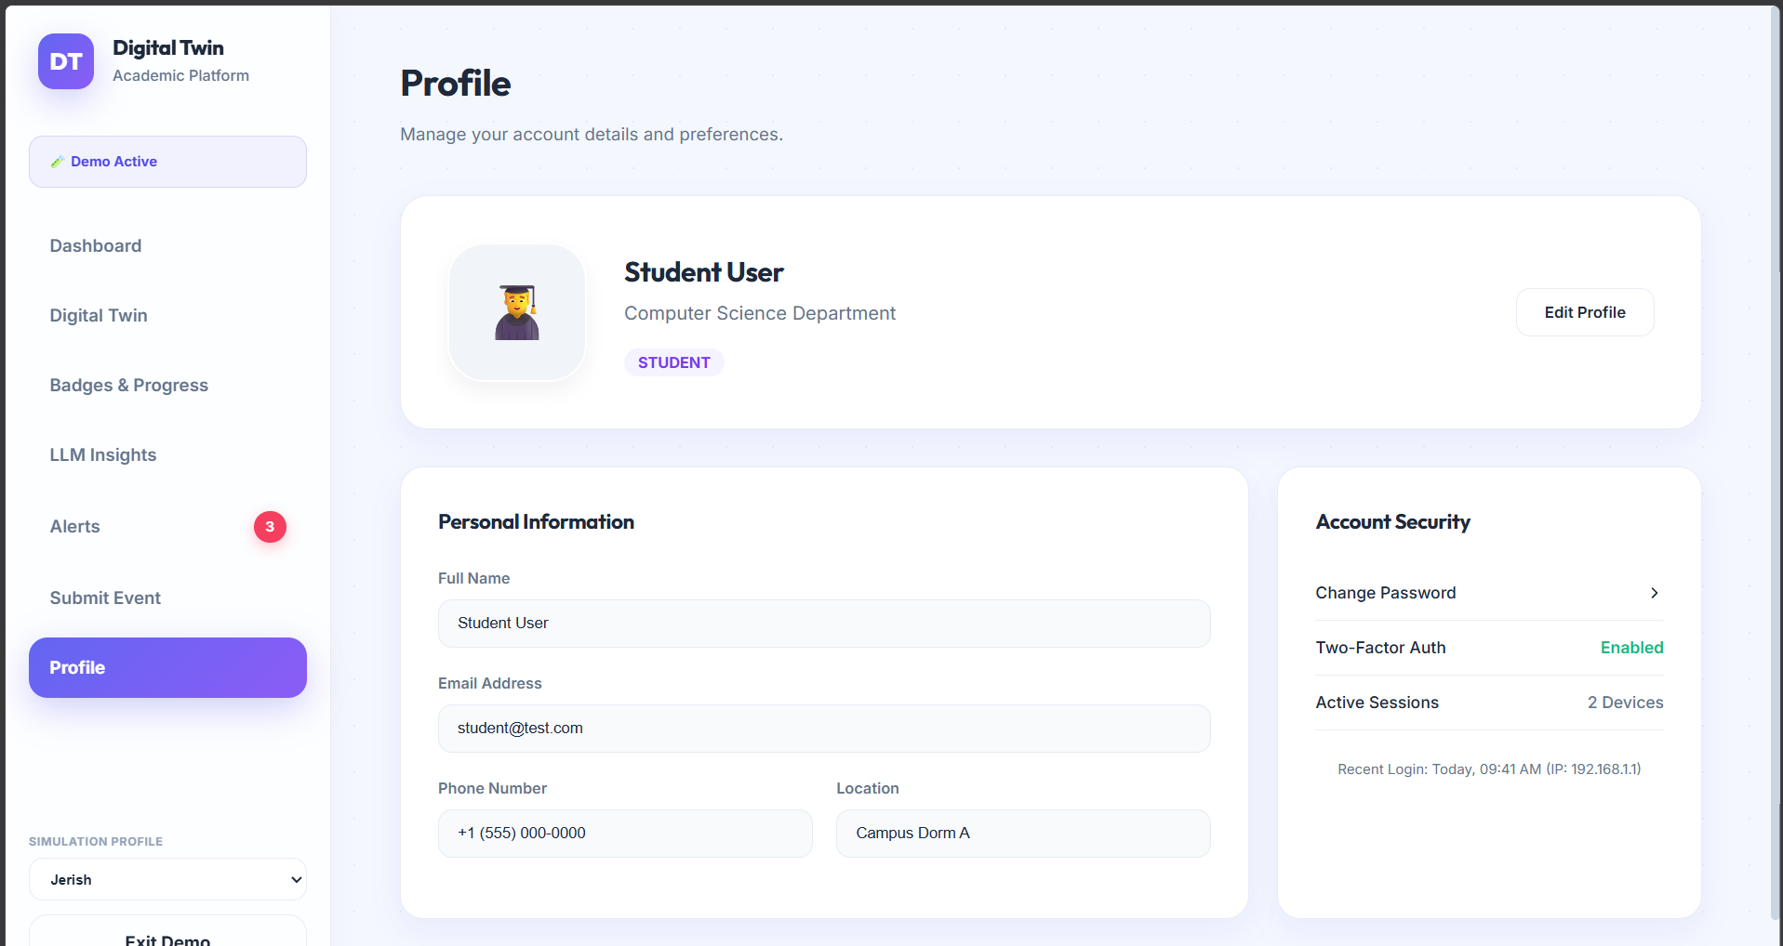
Output Screenshots(Desktop)
1. Student Dashboard
2. Digital Twin – semester progress
3. Badges & Progress
4. Alerts
5. Submit Event
6. Profile
Screenshots from the running prototype in demo / simulation mode.
Notes:
These are sample outputs from our running prototype. First, the student dashboard with predicted CGPA, attendance, risk and a marks trend with forecast. Second, the digital twin page with semester-wise progress and exam details. Third, badges and progress, our gamified rewards. Fourth, alerts, where a critical behaviour alert can be reviewed or dismissed. Fifth, the submit event form that sends a new event to the twin. Sixth, the profile page. All screens are from demo mode with simulated student profiles.

Slide 8
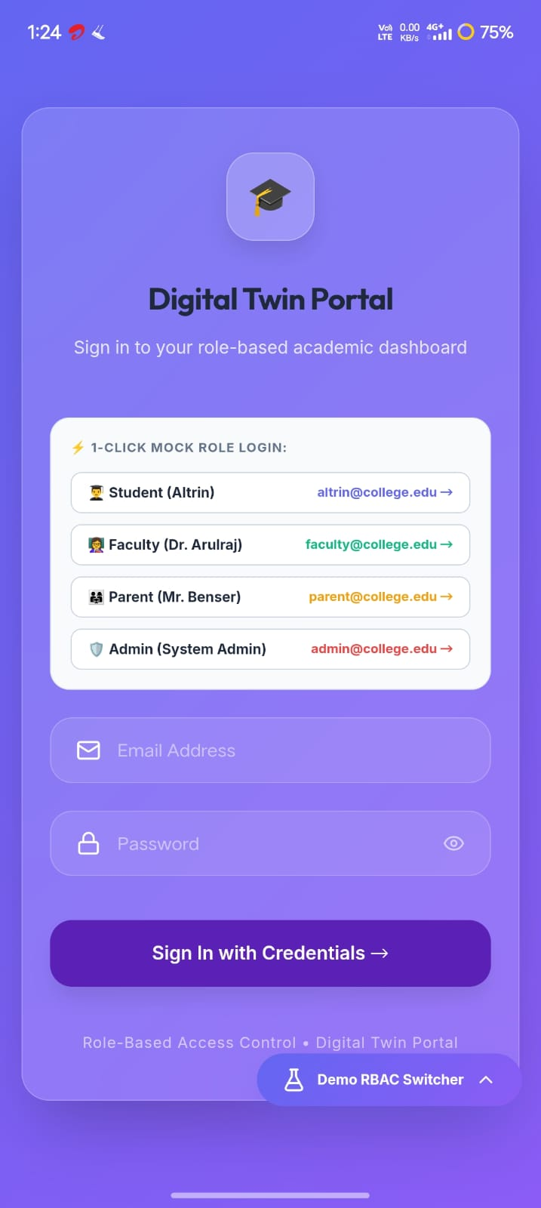
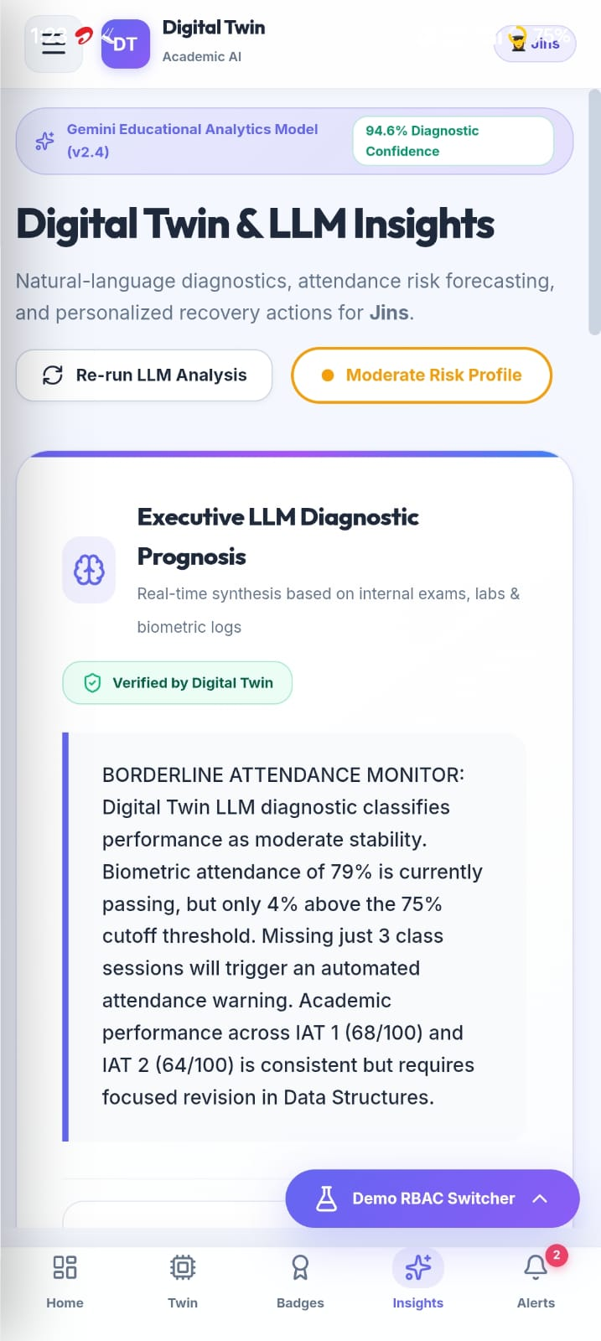
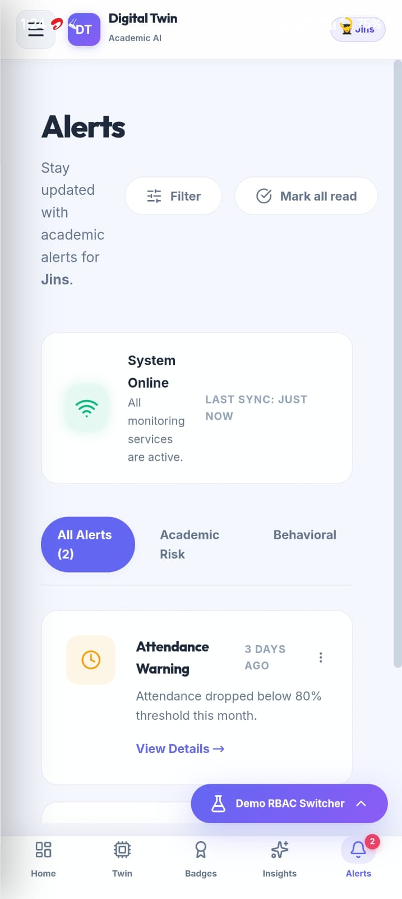
Output Screenshots(Mobile)

Slide 9
Conclusion
Conclusion
Working end-to-end prototype: events → features → risk → Digital Twin → alerts → dashboards
Explainable risk scores with twin snapshots and trend history
JWT login with role-based access for student, teacher, parent and admin
Risk engine is currently rule-based
Future Work
Trained ML model for risk prediction
What-if simulator (shadow twin) for interventions
Closed-loop calibration against real outcomes
PostgreSQL database and deployment
Notes:
To conclude, we built a working end-to-end prototype: events flow into features, risk, the digital twin, alerts and role-based dashboards. Risk scores are explainable, and snapshots give trend history. Login is secured with JWT and role-based access. The risk engine is currently rule-based. Our future work is a trained machine learning model, the what-if simulator, calibration against real outcomes, and a production database with deployment. Thank you.

Slide 10
References
Cagliero et al. (2021). Predicting Student Academic Performance by Means of Associative Classification.
Karalar et al. (2021). Predicting Students at Risk of Academic Failure Using Ensemble Model During Pandemic in a Distance Learning System.
Park & Yoo (2021). Early Dropout Prediction in Online Learning of University Using Machine Learning.
Dabhade et al. (2021). Educational Data Mining for Predicting Students’ Academic Performance Using Machine Learning Algorithms.
Tamada et al. (2022). Predicting Students at Risk of Dropout in Technical Course Using LMS Logs.
Yağcı (2022). Educational Data Mining: Prediction of Students’ Academic Performance Using Machine Learning Algorithms.
Oqaidi et al. (2022). Towards a Students’ Dropout Prediction Model in Higher Education Institutions Using Machine Learning Algorithms.
Segura et al. (2022). Machine Learning Prediction of University Student Dropout: Does Preference Play a Key Role?
Katsuragi & Tanaka (2022). Dropout Prediction by Interpretable Machine Learning Model Towards Preventing Student Dropout.
Su et al. (2022). Applying Machine Learning Technologies to Explore Students’ Learning Features and Performance Prediction.
Plak et al. (2022). Early Warning Systems for More Effective Student Counselling in Higher Education.
Qin et al. (2023). Early Warning of Student Performance With Integration of Subjective and Objective Elements.
Cho et al. (2023). A Study on Dropout Prediction for University Students Using Machine Learning.
Balcıoğlu & Artar (2023). Predicting Academic Performance of Students with Machine Learning.
Nagy & Molontay (2023). Interpretable Dropout Prediction: Towards XAI-Based Personalized Intervention.
Villar & Robledo Velini de Andrade (2024). Supervised Machine Learning Algorithms for Predicting Student Dropout and Academic Success: A Comparative Study.
Vaarma & Li (2024). Predicting Student Dropouts with Machine Learning: An Empirical Study in Finnish Higher Education.
Tiukhova et al. (2024). Explainable Learning Analytics: Assessing the Stability of Student Success Prediction Models by Means of Explainable AI.
Miranda et al. (2024). Machine Learning’s Model-Agnostic Interpretability on the Prediction of Students’ Academic Performance in Video-Conference-Assisted Online Learning.
Alalawi et al. (2024/2025). An Extended Learning Analytics Framework Integrating Machine Learning and Pedagogical Approaches for Student Performance Prediction and Intervention.
Notes:
These twenty references are the papers from our literature survey, covering dropout prediction, early warning systems, educational data mining, explainable AI and learning analytics. Add the journal or venue and DOI for each one in your final citation format before submission.

Slide 11
Participation in Technical Event
Presented at ICAESEM 2026
October 30–31, 2026
Notes:
These twenty references are the papers from our literature survey, covering dropout prediction, early warning systems, educational data mining, explainable AI and learning analytics. Add the journal or venue and DOI for each one in your final citation format before submission.

